Slide 1
SAND Meeting
November 26, 2018

Slide 2
NEW OFFICERS FOR 2019-20
PRESIDENT: MICHAELA GAVIGAN
VICE PRESIDENT: TAYLOR PAETH
SECRETARY: EVELYNNE LEE
TREASURER AND FUNDRAISING CHAIR: MICHELLE DUVALL
DIRECTOR OF SOCIAL MEDIA: REBECCA SCOTT
DAVIS COLLEGE/ACADEMY LIAISON: JOSIE ROMANO

Slide 3
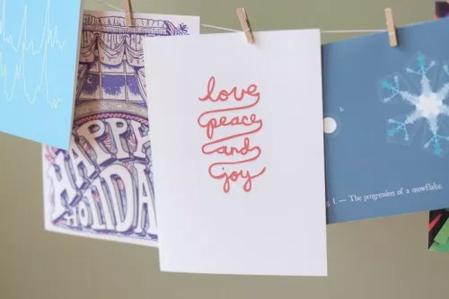
WHAT TO PUT IN THE CARDS
GOING TO ELDERLY HOMES FOR THE HOLIDAYS
CAN SIGN WITH NAME BUT ALSO PUT ORGANIZATION
CAN SIGN WITH JUST ORGANIZATION NAMES
“HAPPY HOLIDAYS”
“MERRY CHRISTMAS”

