Slide 1
Sand Officers
10-29-2018

Slide 2
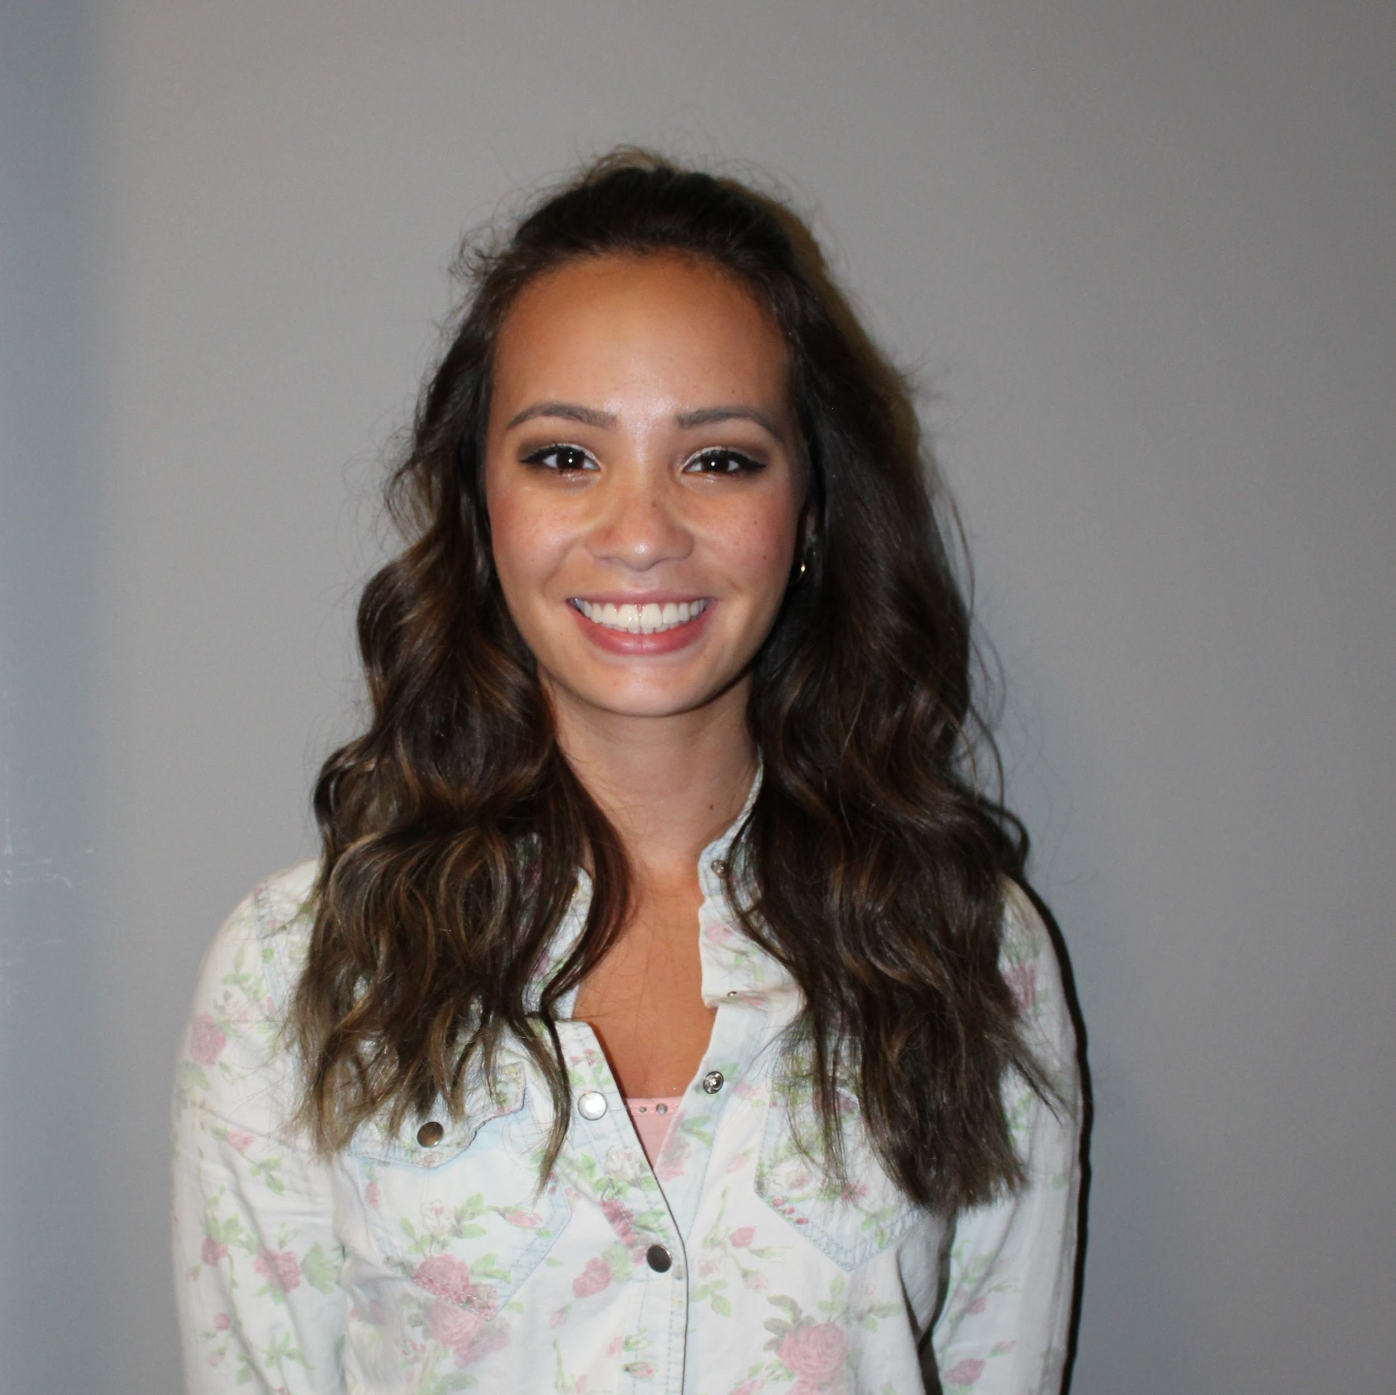
President: Ashton Amos
Year:Senior
Hometown:New Matamoras, Ohio
Future Plans: Masters in Biology and
Biomedical Sciences and to continue
To Medical School

Slide 3
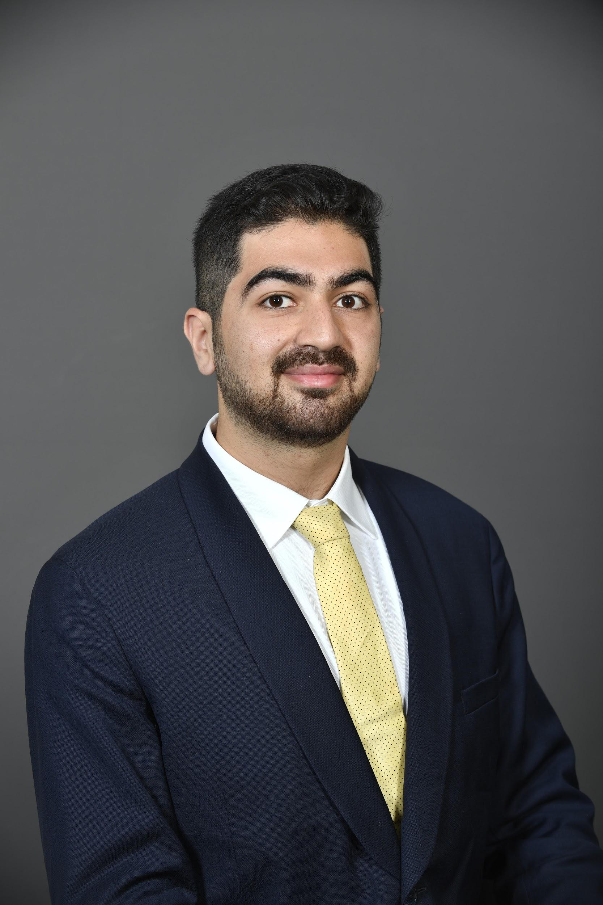
Vice President: Faisal Shahab
Year:Senior
Hometown:Kuwait
Future Plans:Plans to go up for match
and continue with a masters/ PhD.

Slide 4
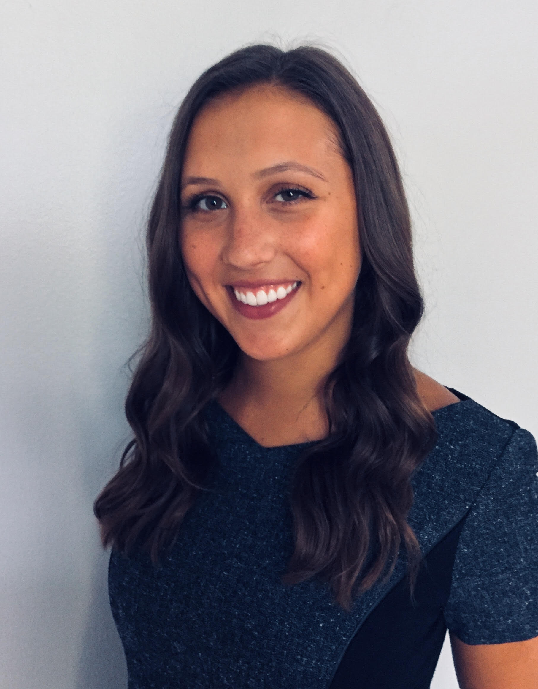
Secretary: Morgan Vucelik
Year:Senior
Hometown:Glendale, WV
Future Plans: Plans to go to Medical
School

Slide 5
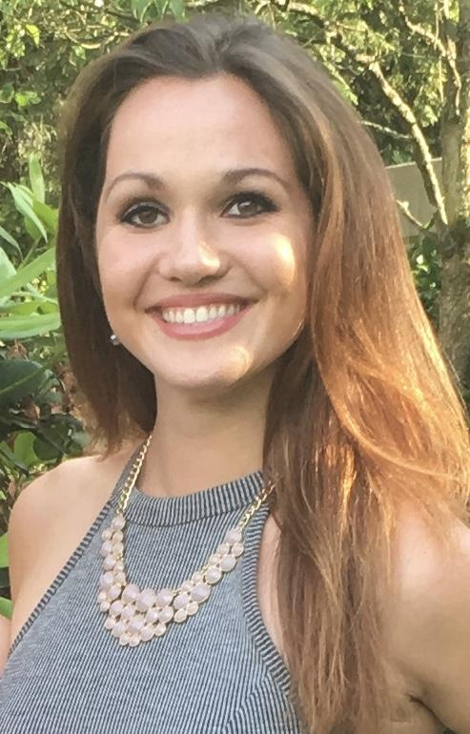
Treasurer: Lindsay Bonneau
Year: Senior
Hometown: Pittsburgh, PA
Future Plans: Plans to go up for match
In the spring and become a clinical
dietitian

Slide 6
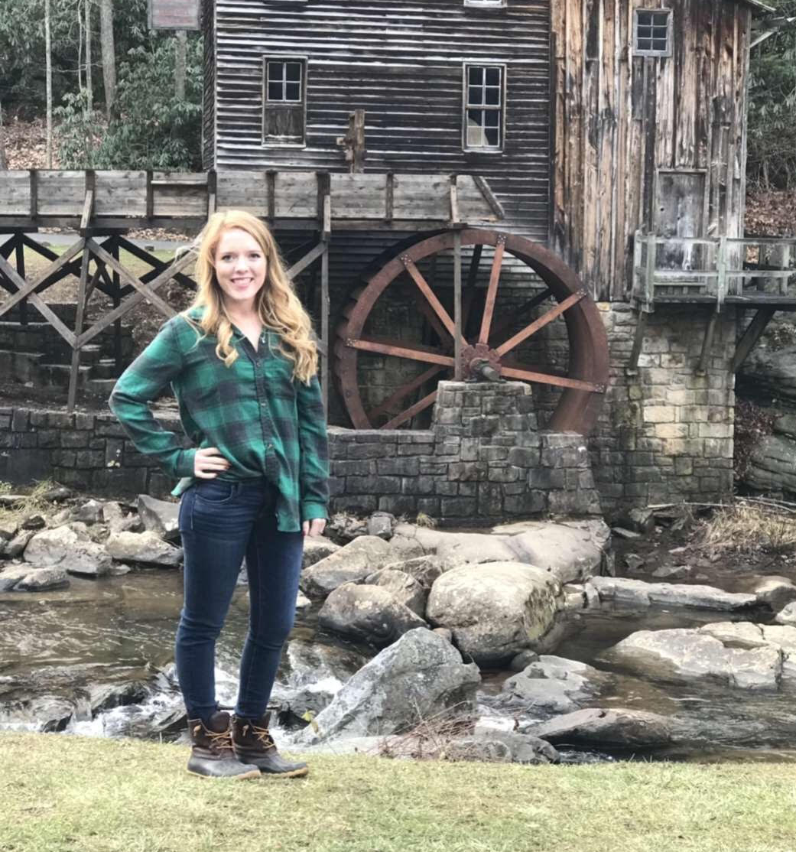
Director of Social Media: Sarah Nething-Moore
Year:Senior
Hometown:Sistersville, WV
Future Plans: To become a registered
Dietitian and eventually a lactation
consultant.

Slide 7
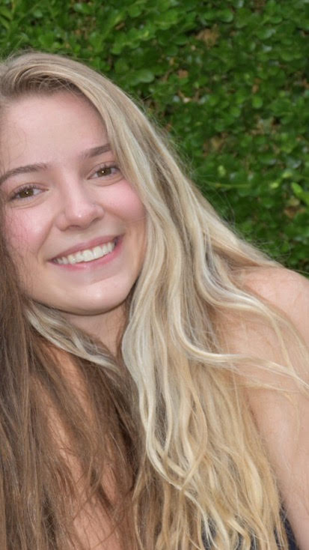
Davis College Liaison: Michaela Gavigan
Year:Senior
Hometown:Bradford, Connecticut
Future Plans:Become a registered
dietitian.

Slide 8
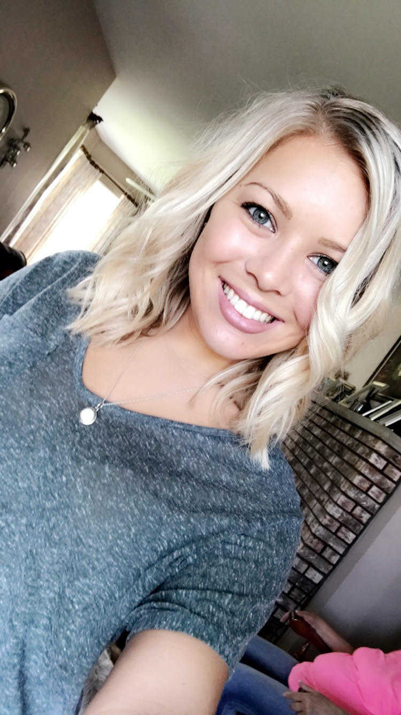
AND Liaison: Taylor Paeth
Year: Junior
Hometown: Fremont, Ohio
Future Plans: Plans to become a registered
Dietitian and specialize in bariatric
dietetics

Slide 9
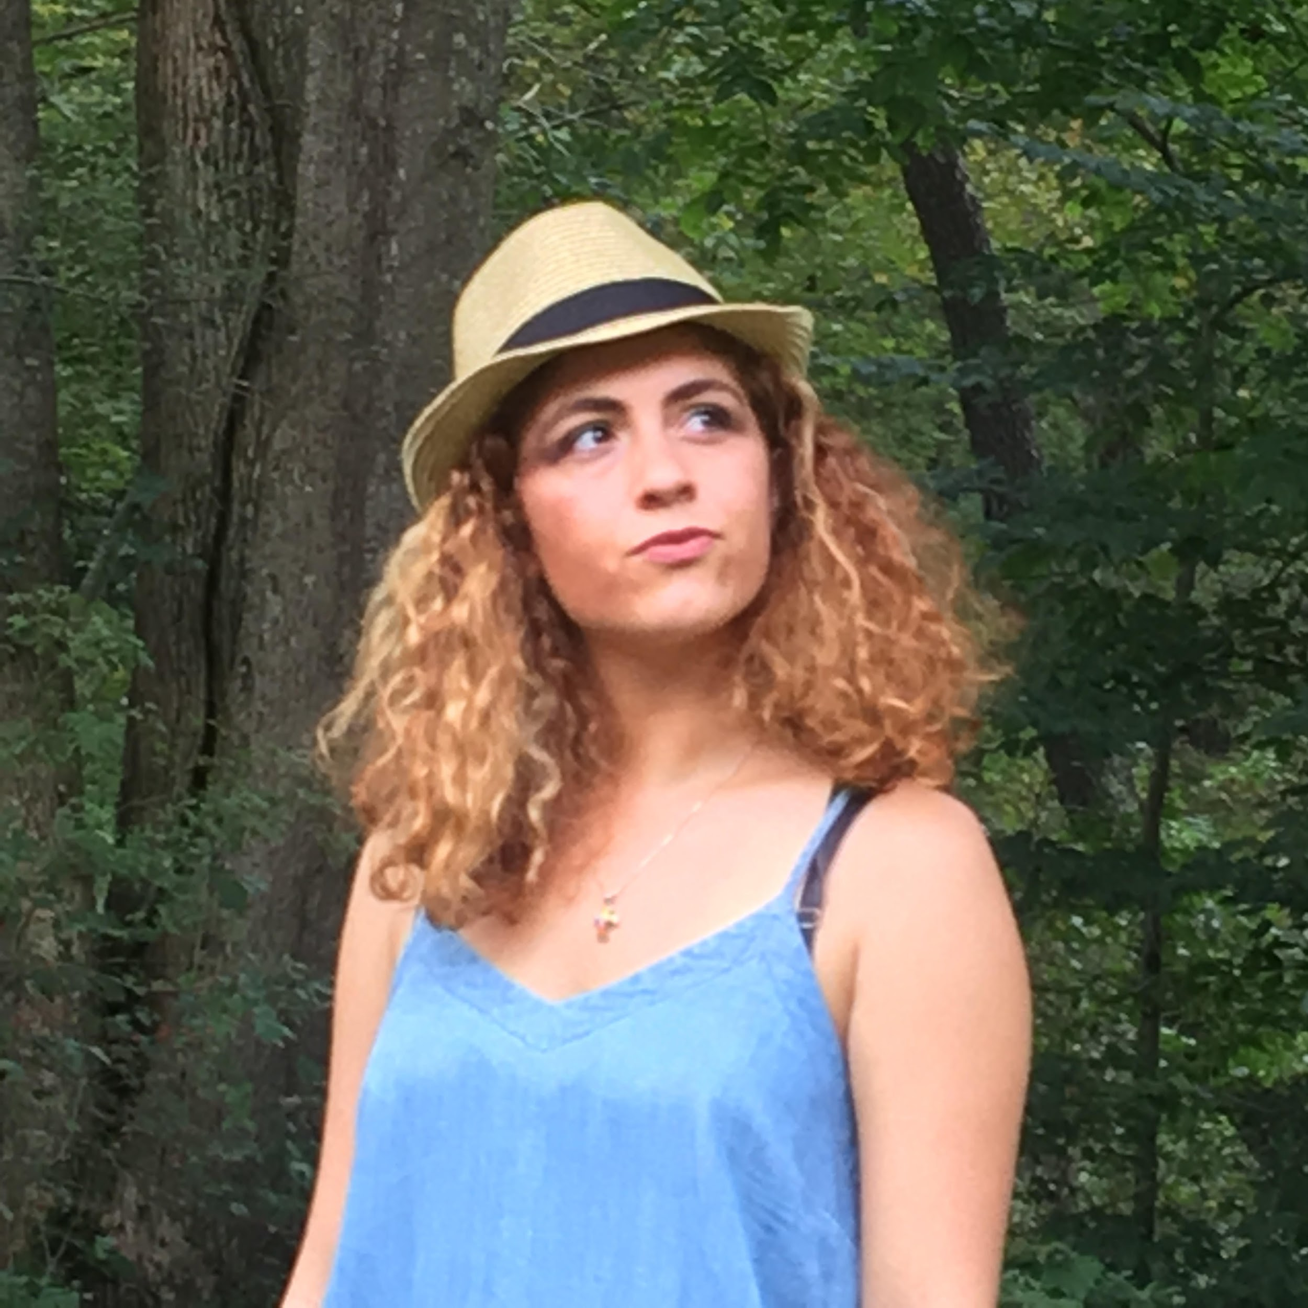
Nutrition Month Committee Head: Alexis Kapostasy
Year: Senior
Hometown: Cincinnati, Ohio
Future Plans: Plans to become a
Registered dietitian

Slide 10
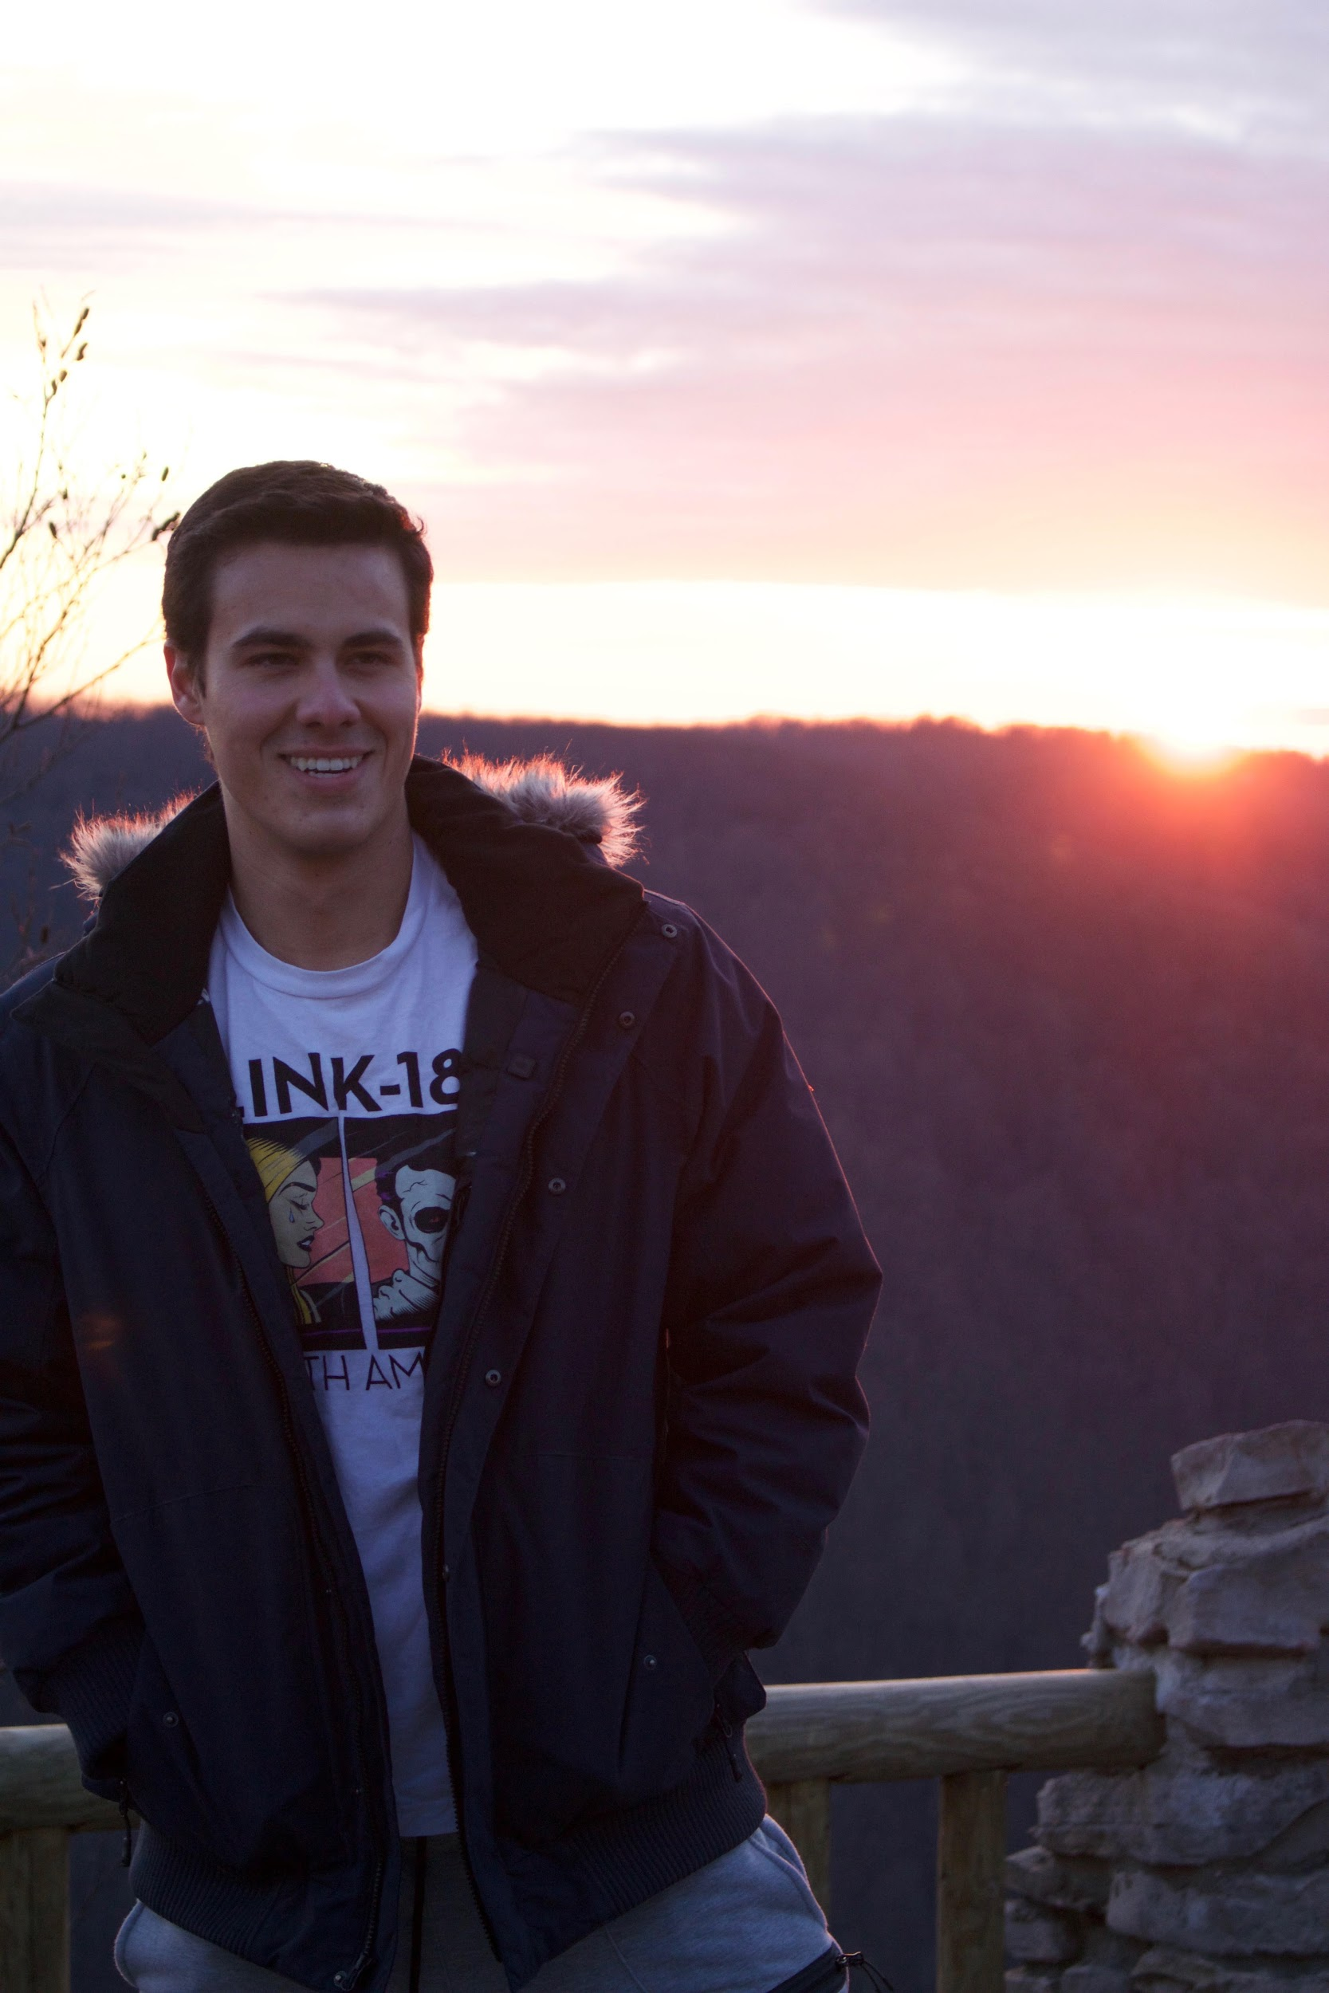
Nutrition Month Committee Head: Matthew Riepe-Gray
Year: Senior
Hometown: LA,CA
Future Plans: Plans to become a sports
dietitian

