Slide 1
Sand Meeting
August 30, 2018

Slide 2
Agenda
Officers and Open Positons
Dues and Active Membership
Peer Notetaking opportunity
Nutrition Month
T-Shirt Fundraisers
Graduation Cords
AND Conference

Slide 3
Officers
President- Ashton Amos
Vice President- Faisal Shahab
Secretary- Morgan Vucelik
Treasurer-Lindsey Bonneau
Director of Social Media- Sarah Moore
Davis College Liaison- Michaela Gavigan
Advisors- Megan Govindan and Nettie Freshour

Slide 4
Open officer positions
Fundraising Chair
AND Liaison

Slide 5
Peer Notetaking
Students may be compensated with up to 16 hours of community service for the semester or letter of recommendation
Nutrition 171
iserve.wvu.edu
search for the OAS Peer notetaker opportunity.
iServe’s website includes instructions on how to apply as a notetaker with OAS and how to complete the notetaker training.

Slide 6
Nutrition Month
Grant opportunity
Mediterranean Mondays, etc
RD Day

Slide 7
Dues
15 per semester or 25 yearly
Please have this by your second meeting

Slide 8
Being an active member
Requirements:
Pay your dues
Attend one event
Go to at least 2 meetings
Point system: person with most points to meetings/events gets free membership dues for the following year or if senior a refund on their dues for this year

Slide 9
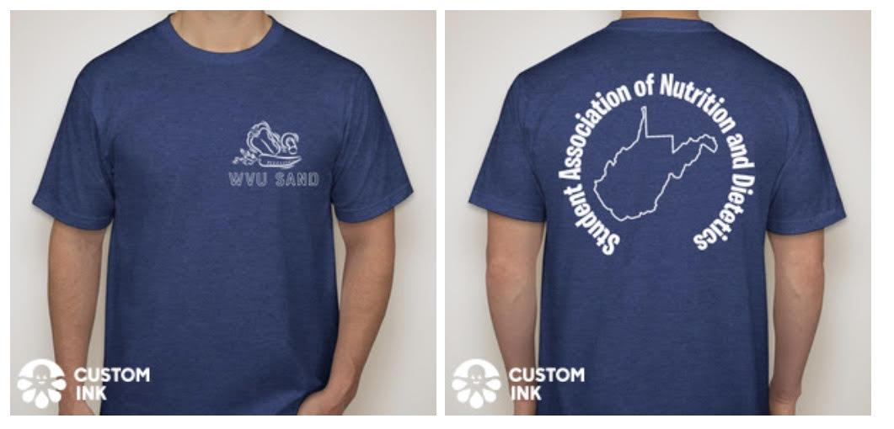
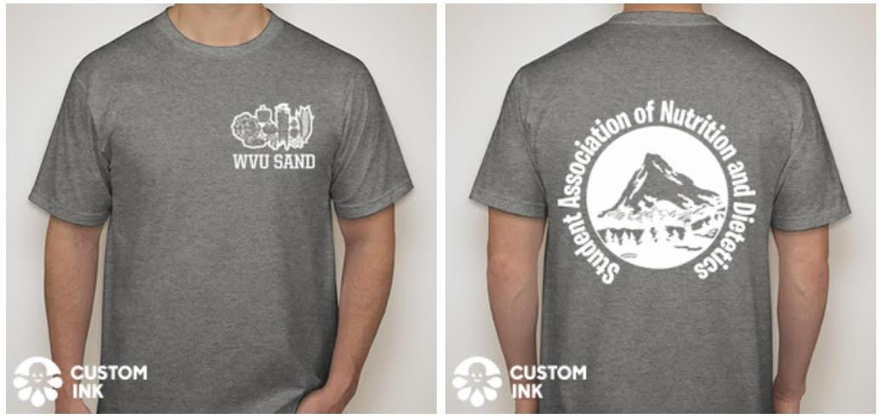
T-Shirt Fundraiser

Slide 10
T-Shirt Fundraiser
Short Sleeve: $20
Long Sleeve: $25
Orders due September 30th
Have money with order
Able to ship orders
Vote on your favorite T-shirt Design + Color!!!!!!!!
We will be doing this twice this year

Slide 11
Graduation Cords
Thoughts?

Slide 12
RD Meet-up
Crossings location

Slide 13
AND Conference
Bridgeport
Volunteer hours for housing Marshall guests possibly

Slide 14
Ideas
Nutrition month
Rethink your drink
Food pantry
AND Conference
Sign Up!!!!!!!!!
For new members it’s okay to send me an email later on if you’re wanting to help ☺

Slide 15
Questions
Questions?

