Slide 1
SAND MEETING #2
9/24/2018

Slide 2
Agenda
Dues
Officer Updates
Fundraising
T-shirts
Roberts Rules
Volunteers needed
Health Fair
Campus Kitchen
Mountaineer week
RD MEET UP!!!!!!

Slide 3
Dues
Due today 25 for the year or 15 for the semester
Venmo is not set up yet but can venmo me @Ashton_Amos

Slide 4
Taylor Paeth- AND Liaison
Updates on opportunities and information from the academy

Slide 5
Michaela- Davis College Liaison
Volunteer choices

Slide 6
Fundraising
Looking for businesses that would allow us to use spots for tax write offs
Also donations

Slide 7
T-shirts
In the process of being designed by licensed vendor
Should be ready by the first of the month hopefully

Slide 8
Roberts Rules
We will be switching to Roberts Rules
This is good professional practice and will help meetings go smoother

Slide 9
Volunteers needed for fair
Wednesday is at 3711 Collins Ferry Road just past the DOE.
Thursday all day and Friday morning is at the Main on Chestnut Ridge 781 Chestnut Ridge Road
Friday afternoon is at GBR location at the old mall 5005 Greenbag Road.

Slide 10
The Campus Kitchen
Megan to talk about this process

Slide 11
MOUNTAINEER WEEK
Appalachian foods themed
Monday, October 22 from 11am to 3pm

Slide 12
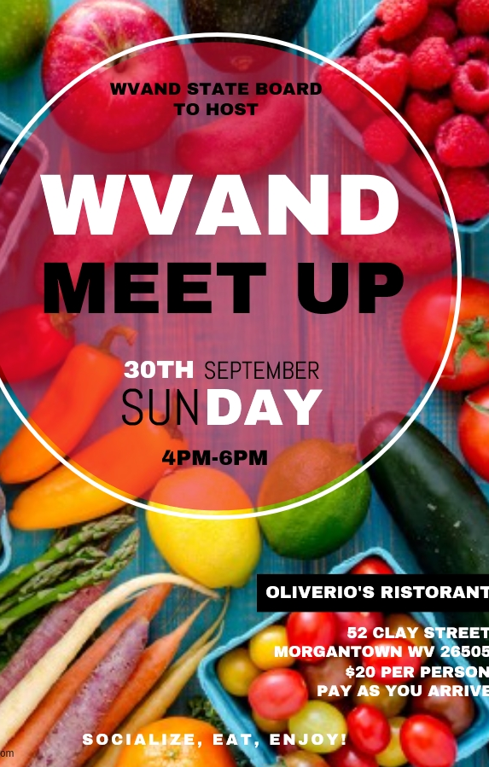
RD Meet up
THIS SUNDAY
4-6pm

